Slide 1
Chapter 1
Databases and Database Users

Slide 2
Chapter 1 Outline
Introduction
An Example
Characteristics of the Database Approach
Actors on the Scene
Workers behind the Scene
Advantages of Using the DBMS Approach
A Brief History of Database Applications
When Not to Use a DBMS

Slide 3
Overview
Traditional database applications
  Store textual or numeric information
Multimedia databases(MMDB)
  Store images, audio clips, and video streams digitally
Geographic information systems (GIS)
  Store and analyze maps, weather data, and satellite images
Notes:
Traditional : Hotel or airline reservation
To understand the fundamentals of database technology, however, we must start from the basics of traditional database applications.

Slide 4
Overview (cont'd.)
Data warehouses (DW) and online analytical processing (OLAP) systems
  Extract and analyze useful business information from very large databases
  Support decision making
Real-time and active database technology
  Control industrial and manufacturing processes
Notes:
By data, we mean known facts that can be recorded and that have implicit meaning. For example, consider the names, telephone numbers, and addresses of the people you know
Data warehouse is a system used for reporting and data analysis, and is considered a core component of business intelligence
Decision support systems(DDS) intend to help decision makers to compile useful information from a combination of raw data, documents, and personal knowledge, or business models to identify and solve problems and make decision.
A real-time database is a database system which uses real-time processing to handle workloads whose state is constantly changing. For example, reservation, banking, etc.

Slide 5
Introduction
Database
  Collection of related data
  Known facts that can be recorded and that have implicit meaning e. g. names, addresses, etc.
  Miniworld or universe of discourse (UoD)
  Represents some aspect of the real world
  Logically coherent collection of data with inherent meaning
  Built for a specific purpose
Notes:
First we start by defining a database, and then we explain other basic terms.
In this chapter, we provide a simple university DATABASE example to illustrate our discussion.

Slide 6
Introduction (cont'd.)
Example of a large commercial database
  Amazon.com
Database management system (DBMS)
  Collection of programs
  Enables users to create and maintain a database
Defining a database
  Specify the data types, structures, and constraints of the data to be stored
Notes:
The DBMS manages 3 important things:
1. The data,
2. The database engine that allows data to be accessed, locked and modified and
3. The database schema, which defines the database’s logical structure.

Slide 7
Introduction (cont'd.)
Meta-data
  Database definition or descriptive information
  Stored by the DBMS in the form of a database catalog or dictionary
Manipulating a database
  Query and update the database miniworld
  Generate reports
Notes:
Metadata is data that describes other data

Slide 8
Introduction (cont'd.)
Sharing a database
  Allow multiple users and programs to access the database simultaneously
Application program
  Accesses database by sending queries to DBMS
Query
  Causes some data to be retrieved

Slide 9
Introduction (cont'd.)
Transaction
  May cause some data to be read and some data to be written into the database
Protection includes:
  System protection
    Against hardware or software malfunction (or crashes)
  Security protection
    Against unauthorized or malicious access
Maintain the database system
  Allow the system to evolve as requirements change over time

Slide 10
An Example
UNIVERSITY database
  Information concerning students, courses, and grades in a university environment
Data records
  STUDENT
  COURSE
  SECTION
  GRADE_REPORT
  PREREQUISITE

Slide 11
An Example (cont'd.)
Specify structure of records of each file by specifying data type for each data element
  String of alphabetic characters
  Integer
  Date
  Time
  Boolean
  ...

Slide 12
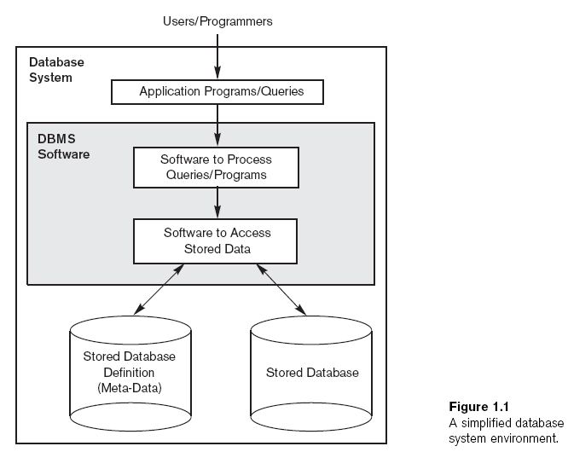
Notes:
A Simplified database system environment -
Component of a database System

Slide 13
An Example (cont'd.)
Construct UNIVERSITY database
  Store data to represent each student, course, section, grade report, and prerequisite as a record in appropriate file
Relationships among the records
Manipulation involves querying and updating

Slide 14
An Example (cont'd.)
Examples of queries:
  Retrieve the transcript
  List the names of students who took the section of the ‘Database’ course offered in fall 2017 and their grades in that section
  List the prerequisites of the ‘Database’ course

Slide 15
An Example (cont'd.)
Examples of updates:
  Change the class of ‘Smith’ to sophomore
  Create a new section for the ‘Database’ course for this semester
  Enter a grade of ‘A’ for ‘Smith’ in the ‘Database’ section of last semester

Slide 16
An Example (cont'd.)
Phases for designing a database:
  Requirements specification and analysis
  1. Conceptual design
    Requirements represented and manipulated using some computerized tools so that it can be easily maintained, modified, and transformed into a database implementation.
  2. Logical design
    The design is then translated to a logical design that can be expressed in a data model implemented in a commercial DBMS (we’ll emphasize a data model known as the Relational Data Model from chapter 3 onward).
Notes:
Conceptual Design : We will introduce a model called the Entity-Relationship model in Chapter 7 that is used for this purpose.
Relational Data Model is currently the most popular approach for designing and implementing databases using relational DBMSs

Slide 17
An Example (cont'd.)
Phases for designing a database:
  Requirements specification and analysis
  3. Physical design
    Further specifications are provided for storing and accessing the database.
  The database design is implemented, populated with actual data, and continuously maintained to reflect the state of the miniworld
  The logical design is more conceptual and abstract than the physical design. In the logical design, we look at the logical relationships among the objects/data. In the physical design, we look at the most effective way of storing and retrieving the objects/data.
Notes:
Physical database design translates the logical data model into a set of SQL statements that define the database

Slide 18
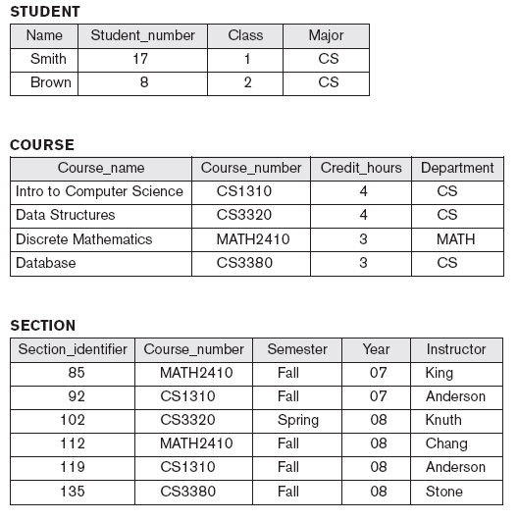
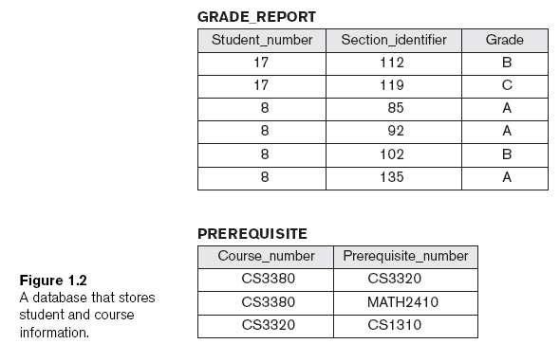
Notes:
A Database that stores student and course information
What are the relationships among the records of the database

Slide 19
Characteristics of the Database Approach
Traditional file processing
  Each user defines and implements the files needed for a specific software application
Database approach
  Single repository maintains data that is defined once and then accessed by various users
Notes:
Distinguish the database approach from the much older approach of programming with files

Slide 20
Characteristics of the Database Approach (cont'd.)
Main characteristics of database approach
  Self-describing nature of a database system
  Insulation between programs and data, and data abstraction
  Support of multiple views of the data
    A view is a subset of the database
  Sharing of data and multiuser transaction processing
    Using concurrency control strategies
Notes:
A database system is referred to as self-describing because it not only contains the database itself, but also metadata which defines and describes the data and relationships between tables in the database.
In the file-based system, the structure of the data files is defined in the application programs so if a user wants to change the structure of a file, all the programs that access that file might need to be changed as well. On the other hand, in the database approach, the data structure is stored in the system catalogue and not in the programs. Therefore, one change is all that is needed to change the structure of a file.

Slide 21
Self-Describing Nature of a Database System
Database system contains complete definition of structure and constraints
Meta-data
  Describes structure of the database
Database catalog used by:
  DBMS software
  Database users who need information about database structure

Slide 22
Insulation Between Programs and Data
Program-data independence
  Structure of data files is stored in DBMS catalog separately from access programs
Program-operation independence
  Operations(also called a function or method) specified in two parts:
    Interface (or signature) includes operation name and data types of its arguments
    Implementation (or method) can be changed without affecting the interface
Notes:
In some types of database systems, (such as object-oriented and object-relational systems) users can define operations on data as part of the database definitions (which is discussed in Chapter 11)
User application programs can operate on the data by invoking these operations through their names and arguments, regardless of how the operations are implemented

Slide 23
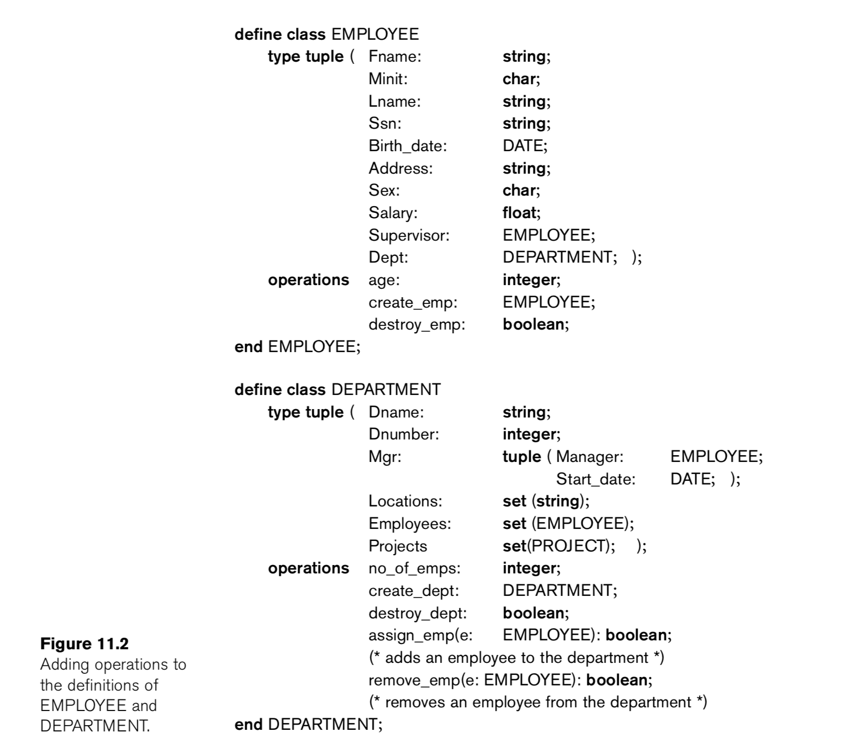
Object-Oriented database - Example

Slide 24
Data Abstraction
Data abstraction
  Allows program-data independence and program-operation independence
Conceptual representation of data
  Does not include details of how data is stored or how operations are implemented
Data model
  Type of data abstraction used to provide conceptual representation
Notes:
Data Abstraction: There are many database users who are not computer trained, so developers hide the complex portion of database from users through several levels of abstraction.
The data model uses logical concepts, such as objects, their properties, and their interrelationships.. Therefore, the data model hides storage and implementation details that are not of interest to most database users.
Conceptual or high level : Describes what data are stored in the database and the relationship among the data.

Slide 25
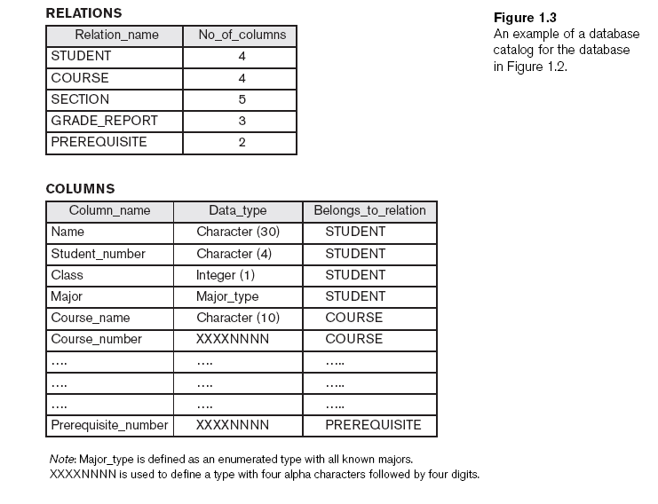
Notes:
An example of a database catalog for the database in the previous figure
Note : Major-type is defined as an enumerated type with all known majors. One of the advantages of enumerated types (enum) is that it can allow compilers to enforce semantic correctness.
For example, myColor = TRIANGLE can be forbidden, whilst myColor = BLUE
XXXXXNNNN is used to define a type with four alpha characters followed by four digits.

Slide 26
Support of Multiple Views of the Data
View
  Subset of the database
  Contains virtual data derived from the database files but is not explicitly stored
Multiuser DBMS
  Users have a variety of distinct applications
  Must provide facilities for defining multiple views
Notes:
View level: The highest level describes only a part of database because this is the user level

Slide 27
Sharing of Data and Multiuser Transaction Processing
Allow multiple users to access the database at the same time
Concurrency control software
  Ensure that several users trying to update the same data do so in a controlled manner
    Result of the updates is correct
Online transaction processing (OLTP) application
  Manages transaction-oriented applications
Notes:
OLTP : Information systems that facilitate and manage transaction-oriented applications, typically for data entry and retrieval transaction processing.

Slide 28
Sharing of Data and Multiuser Transaction Processing (cont'd.)
Transaction
  Central to many database applications
  Executing program or process that includes one or more database
  Isolation property
    Each transaction appears to execute in isolation from other transactions
  Atomicity property
    Either all the database operations in a transaction are executed or none are

Slide 29
Actors on the Scene
Database administrators (DBA) are responsible for:
  Authorizing access to the database
  Coordinating and monitoring its use
  Acquiring software and hardware resources
Database designers are responsible for:
  Identifying the data to be stored
  Choosing appropriate structures to represent and store this data
Notes:
The DBA is a person or a group of persons who is responsible for the management of the database
Authentication vs Authorization
Authentication is the process of verifying who you are
Authorization is the process of verifying that you have access to something

Slide 30
Actors on the Scene (cont'd.)
End users
  People whose jobs require access to the database
  People who interact with the database through applications or utilities
  Types
    Casual end users
    Naive or parametric end users
    Sophisticated end users
    Standalone users
Notes:
1. Casual end users : There are people who use the database occasionally. these are the temporary users (Manager).
2. Naïve or parametric end users : There are users who constantly querying and updating database. e. g. Reservation clerks for airlines/hotels, insurance agencies.
3. Sophisticated end users : People who use database for their complex requirement. e.g. engineers, scientists , and business analysts.
4. Standalone users : who maintain the database for personal use

Slide 31
Actors on the Scene (cont'd.)
System analysts
  Determine requirements of end users
Application programmers
  Implement these specifications as programs
Notes:
Brainstorming,
Document Analysis,
Interview,
Observation,
Prototyping (using Storyboards and interfaces),
Workshop,
Survey

Slide 32
Workers behind the Scene
DBMS system designers and implementers
  Design and implement the DBMS modules and interfaces as a software package
Tool developers
  Design and implement tools
Operators and maintenance personnel
  Responsible for running and maintenance of hardware and software environment for database system

Slide 33
Advantages of Using the DBMS Approach
Controlling redundancy
  Data normalization
  Denormalization
    Sometimes necessary to use controlled redundancy to improve the performance of queries
Restricting unauthorized access
  Security and authorization subsystem

Slide 34
Advantages of Using the DBMS Approach (cont'd.)
Providing persistent storage for program objects
  Complex object in C++ can be stored permanently in an object-oriented DBMS

Slide 35
Advantages of Using the DBMS Approach (cont'd.)
Providing storage structures and search techniques for efficient query processing
  Indexes
  Buffering and caching
  Query processing and optimization
Notes:
An index is a copy of selected columns of data from a table that can be searched efficiently that also includes a low-level disk block address

Slide 36
Advantages of Using the DBMS Approach (cont'd.)
 | BUFFERING | CACHING
Basics | A buffer is a region of memory used to temporarily hold data while it is being moved from one place to another within a computer | a temporary storage area where frequently accessed data can be stored for rapid access.
Stores | Buffer stores the original copy of data. | Cache stores the copy of original data.
Location | Buffer is an area in primary memory (RAM). | Cache is implemented on the processor it can be implemented on RAM and disk as well.

Slide 37
Advantages of Using the DBMS Approach (cont'd.)
Providing backup and recovery
  Backup and recovery subsystem of the DBMS is responsible for recovery
Providing multiple user interfaces
  Graphical user interfaces (GUIs)
Representing complex relationships among data
  May include numerous varieties of data that are interrelated in many ways
Notes:
Using logs for recovery

Slide 38
Advantages of Using the DBMS Approach (cont'd.)
Enforcing integrity constraints
  Referential integrity constraint
    e. g. every section record must be related to a course record
  Key or uniqueness constraint
    Every course record must have a unique value for Course_number

Slide 39
Advantages of Using the DBMS Approach (cont'd.)
Permitting inferencing and actions using rules
  Deductive database systems
    Provide capabilities for defining deduction rules
    Inferencing new information from the stored database facts
  Trigger
    Rule activated by updates to the table
    Initiate actions when certain events and conditions occur.
  Stored procedures
    More involved procedures to enforce rules
Notes:
Deduction Rules:
For example, there may be complex rules in the application for determining when a student is on probation. These can be specified as rules, which when compiled and maintained by the DBMS can determine all students on probation. In a traditional DBMS, an explicit procedural program code would have to be written to support such applications.

Slide 40
Advantages of Using the DBMS Approach (cont'd.)
Additional implications of using the database approach
  Reduced application development time
  Flexibility
  Availability of up-to-date information

Slide 41
A Brief History of Database Applications
Early database applications using hierarchical and network systems
  Large numbers of records of similar structure
Providing data abstraction and application flexibility with relational databases
  Separates physical storage of data from its conceptual representation
  Provides a mathematical foundation for data representation and querying

Slide 42
A Brief History of Database Applications (cont'd.)
Object-oriented applications and the need for more complex databases
  Used in specialized applications: engineering design, multimedia publishing, and manufacturing systems
Interchanging data on the Web for e-commerce using XML
  Extended markup language (XML) primary standard for interchanging data among various types of databases and Web pages

Slide 43
A Brief History of Database Applications (cont'd.)
Extending database capabilities for new applications
  Extensions to better support specialized requirements for applications
  Enterprise resource planning (ERP)
  Customer relationship management (CRM)
Notes:
ERP allows an organization to use a system of integrated applications to manage the business and automate many back office functions related to technology, services and human resources

Slide 44
When Not to Use a DBMS
More desirable to use regular files for:
  Simple, well-defined database applications not expected to change at all
  Stringent, real-time requirements that may not be met because of DBMS overhead
  Embedded systems with limited storage capacity
  No multiple-user access to data

Slide 45
Summary
Database
  Collection of related data (recorded facts)
DBMS
  Generalized software package for implementing and maintaining a computerized database
Several categories of database users
Database applications have evolved

